Slide 1



Chapter 8
การเข้าแถวคอยและการจําลอง
Queuing and Simulation
Asst.Prof. Juthawut Chantharamalee
Program in Computer Science, Science and Technology of Faculty, Suan Dusit University

Slide 2
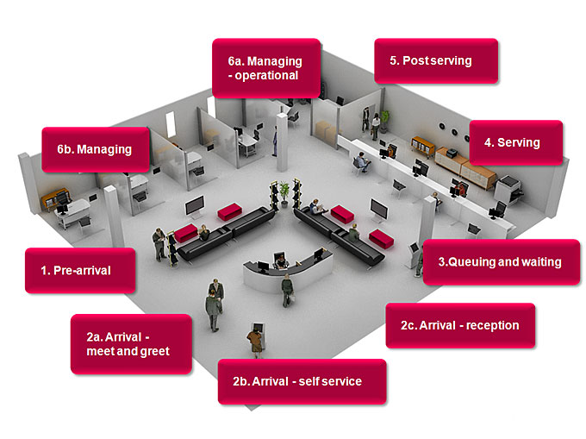
Overview (I)
What is queuing/ queuing theory?
  Why is it an important tool?
  Examples of different queuing systems
Components of a queuing system
The exponential distribution & queuing
Stochastic processes
  Some definitions
  The Poisson process
Terminology and notation
Little’s formula
Birth and Death Processes

Slide 3
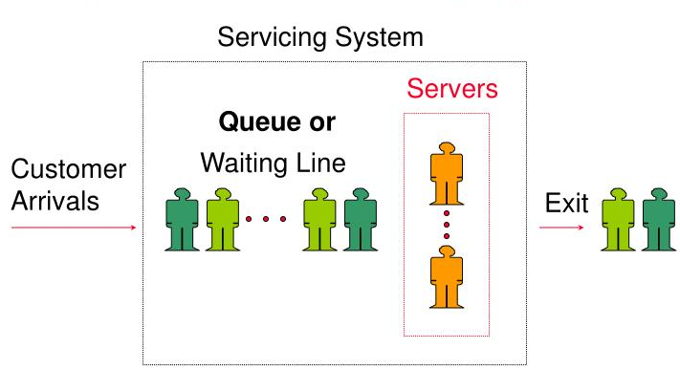
Overview (II)
Important queuing models with FIFO discipline
  The M/M/1 model
  The M/M/c model
  The M/M/c/K model (limited queuing capacity)
  The M/M/c/∞/N model (limited calling population)
Priority-discipline queuing models
Application of Queuing Theory to system
design and decision making

Slide 4
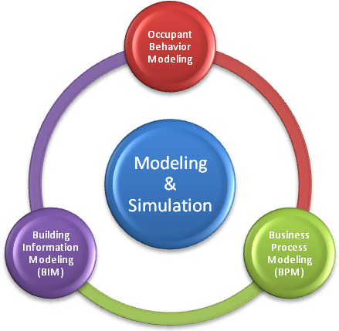
Overview (III)
Simulation – What is that?
  Why is it an important tool?
Building a simulation model
  Discrete event simulation
Structure of a BPD simulation project
Model verification and validation
Example – Simulation of a M/M/1 Queue

Slide 5
What is Queuing Theory?
Mathematical analysis of queues and waiting times in stochastic systems.
  Used extensively to analyze production and service processes exhibiting random variability in market demand (arrival times) and service times.
Queues arise when the short term demand for service exceeds the capacity
  Most often caused by random variation in service times and the times between customer arrivals.
  If long term demand for service > capacity the queue will explode!

Slide 6
Why is Queuing Analysis Important?
Capacity problems are very common in industry and one of the main drivers of process redesign
  Need to balance the cost of increased capacity against the gains of increased productivity and service
Queuing and waiting time analysis is particularly important in service systems
  Large costs of waiting and of lost sales due to waiting
Prototype Example – ER at County Hospital
Patients arrive by ambulance or by their own accord
One doctor is always on duty
More and more patients seeks help ⇒ longer waiting times
Question: Should another MD position be instated?

Slide 7
A Cost/Capacity Tradeoff Model
Total
cost
Cost
Cost of
service
Cost of waiting
Process capacity

Slide 8
Examples of Real World Queuing Systems?
Commercial Queuing Systems
  Commercial organizations serving external customers
  Ex. Dentist, bank, ATM, gas stations, plumber, garage …
Transportation service systems
  Vehicles are customers or servers
  Ex. Vehicles waiting at toll stations and traffic lights, trucks or ships waiting to be loaded, taxi cabs, fire engines, elevators, buses …
Business-internal service systems
  Customers receiving service are internal to the organization providing the service
  Ex. Inspection stations, conveyor belts, computer support …
Social service systems
  Ex. Judicial process, the ER at a hospital, waiting lists for organ transplants or student dorm rooms …

Slide 9
Components of a Basic Queuing Process
Input Source
The Queuing System
Served Jobs
Jobs
Calling Population
Queue
Service Mechanism
leave the system
Arrival Process
Queue Discipline
Queue Configuration
Service Process

Slide 10
Components of a Basic Queuing Process (II)
The calling population
  The population from which customers/jobs originate
  The size can be finite or infinite (the latter is most common)
  Can be homogeneous (only one type of customers/ jobs) or heterogeneous (several different kinds of customers/jobs)
The Arrival Process
  Determines how, when and where customer/jobs arrive to the system
  Important characteristic is the customers’/jobs’ inter-arrival times
  To correctly specify the arrival process requires data collection of interarrival times and statistical analysis.

Slide 11
Components of a Basic Queuing Process (III)
The queue configuration
  Specifies the number of queues
    Single or multiple lines to a number of service stations
  Their location
  Their effect on customer behavior
    Balking and reneging
  Their maximum size (# of jobs the queue can hold)
    Distinction between infinite and finite capacity

Slide 12
Example – Two Queue Configurations
Multiple Queues
Single Queue
Servers
Servers

Slide 13
Multiple v.s. Single Customer Queue Configuration
Multiple Line Advantages
Single Line Advantages
The service provided can be differentiated
  Ex. Supermarket express lanes
Labor specialization possible
Customer has more flexibility
Balking behavior may be deterred
  Several medium-length lines are less intimidating than one very long line
Guarantees fairness
  FIFO applied to all arrivals
No customer anxiety regarding choice of queue
Avoids “cutting in” problems
The most efficient set up for minimizing time in the queue
Jockeying (line switching) is avoided

Slide 14
Components of a Basic Queuing Process (IV)
The Service Mechanism
  Can involve one or several service facilities with one or several parallel service channels (servers)
  - Specification is required
  The service provided by a server is characterized by its service time
    Specification is required and typically involves data gathering and statistical analysis.
    Most analytical queuing models are based on the assumption of exponentially distributed service times, with some generalizations.
The queue discipline
  Specifies the order by which jobs in the queue are being served.
  Most commonly used principle is FIFO.
  Other rules are, for example, LIFO, SPT, EDD…
  Can entail prioritization based on customer type.

Slide 15
Mitigating Effects of Long Queues
Concealing the queue from arriving customers
  Ex. Restaurants divert people to the bar or use pagers, amusement parks require people to buy tickets outside the park, banks broadcast news on TV at various stations along the queue, casinos snake night club queues through slot machine areas.
Use the customer as a resource
  Ex. Patient filling out medical history form while waiting for physician
Making the customer’s wait comfortable and distracting their attention
  Ex. Complementary drinks at restaurants, computer games, internet stations, food courts, shops, etc. at airports
Explain reason for the wait
Provide pessimistic estimates of the remaining wait time
  Wait seems shorter if a time estimate is given.
Be fair and open about the queuing disciplines used

Slide 16
A Commonly Seen Queuing Model (I)
The Queuing System
The Service Facility
C S = Server
C S
•
•
•
C S
The Queue
Customers (C)
C C C … C
Customer =C

Slide 17

A Commonly Seen Queuing Model (II)
Service times as well as interarrival times are assumed independent and identically distributed
  If not otherwise specified
Commonly used notation principle: A/B/C
  A = The interarrival time distribution
  B = The service time distribution
  C = The number of parallel servers
Commonly used distributions
  M = Markovian (exponential) - Memoryless
  D = Deterministic distribution
  G = General distribution
Example: M/M/c
  Queuing system with exponentially distributed service and inter-arrival times and c servers

Slide 18
The Exponential Distribution and Queuing
The most commonly used queuing models are based on the assumption of exponentially distributed service times and interarrival times.
Definition: A stochastic (or random) variable T∈exp(α ), i.e., is exponentially distributed with parameter α, if its frequency function is:
⇒ The Cumulative Distribution Function is:
⇒ The mean = E[T] = 1/α
⇒ The Variance = Var[T] = 1/ α²

Slide 19
The Exponential Distribution
f_{T}(t)
α
SDU-COM-SCI
Probability density
t
Mean= E[T] =1/α
Time between arrivals

Slide 20
Properties of the Exp-distribution (I)
Property 1: f_{T}(t) is strictly decreasing in t
⇔ P(0≤T≤Δt) > P(t ≤T ≤t+Δt) for all t, Δt≥0
Implications
  Many realizations of T (i.e.,values of t) will be small; between zero and the mean
  Not suitable for describing the service time of standardized operations when all times should be centered around the mean
    Ex. Machine processing time in manufacturing
  Often reasonable in service situations when different customers require different types of service
  Often a reasonable description of the time between customer arrivals

Slide 21
Properties of the Exp-distribution (II)
Property 2: Lack of memory
⇔ P(T>t+Δt | T>t) = P(T >Δt) for all t, Δt≥0
Implications
  It does not matter when the last customer arrived, (or how long service time the last job required) the distribution of the time until the next one arrives (or the distribution of the next service time) is always the same.
  Usually a fair assumption for interarrival times
  For service times, this can be more questionable. However, it is definitely reasonable if different customers/jobs require different service

Slide 22
Properties of the Exp-distribution (III)
Property 3: The minimum of independent exponentially distributed random variables is exponentially distributed
Assume that {T₁, T₂, …, T_{n}} represent n independent and exponentially distributed stochastic variables with parameters {α₁, α₂, …, α_{n}}.
Let U=min {T₁, T₂, …, T_{n}} ⇒
Implications
  Arrivals with exponentially distributed interarrival times from n different input sources with arrival intensities {λ₁, λ₂, …, λ_{n}} can be treated as a homogeneous process with exponentially distributed interarrival times of intensity λ= λ₁+ λ₂+…+ λ_{n}.
  Service facilities with n occupied servers in parallel and service intensities {μ₁, μ₂, …, μ_{n}} can be treated as one server with service intensity μ= μ₁+μ₂+…+μ_{n}

Slide 23
Properties of the Exp-distribution (IV)
Relationship to the Poisson distribution and the Poisson Process
Let X(t) be the number of events occurring in the interval [0,t]. If the time between consecutive events is T and T∈exp(α)
⇔ X(t)∈Po(αt) ⇔ {X(t), t≥0} constitutes a Poisson Process

Slide 24
Stochastic Processes in Continuous Time
Definition: A stochastic process in continuous time is a family {X(t)} of stochastic variables defined over a continuous set of t-values.
Example: The number of phone calls connected through a switch board
Definition: A stochastic process {X(t)} is said to have independent increments if for all disjoint intervals (t_{i}, t_{i}+h_{i}) the differences X_{i}(t_{i}+h_{i})−X_{i}(t_{i}) are mutually independent.
X(t)=# Calls
t

Slide 25
The Poisson Process
The standard assumption in many queuing models is that the arrival process is Poisson
Two equivalent definitions of the Poisson Process
The times between arrivals are independent, identically distributed and exponential
X(t) is a Poisson process with arrival rate λ iff.
  X(t) have independent increments
  b) For a small time interval h it holds that
    P(exactly 1 event occurs in the interval [t, t+h]) = λh + o(h)
    P(more than 1 event occurs in the interval [t, t+h]) = o(h)

Slide 26
Properties of the Poisson Process
Poisson processes can be aggregated or disaggregated and the resulting processes are also Poisson processes
a) Aggregation of N Poisson processes with intensities
{λ₁, λ₂, …, λ_{n}} renders a new Poisson process with intensity λ= λ₁+ λ₂+…+ λ_{n}.
b) Disaggregating a Poisson process X(t)∈Po(λt) into N sub-processes {X₁(t), X₂(t), , …, X₃(t)} (for example N customer types) where X_{i}(t) ∈Po(λ_{i}t) can be done if
– For every arrival the probability of belonging to sub-process i = p_{i}
– p₁+ p₂+…+ p_{N} = 1, and λ_{i} = p_{i} λ

Slide 27
Illustration – Disaggregating a Poisson Process
p₁
X(t)∈Po(λt)
p₂
p_{N}

Slide 28
Terminology and Notation
The state of the system = the number of customers in the system
Queue length = (The state of the system) – (number of customers being served)
N(t) = Number of customers/jobs in the system at time t
P_{n}(t) = The probability that at time t, there are n customers/jobs in the system.
λ_{n} = Average arrival intensity (= # arrivals per time unit) at n customers/jobs in the system
μ_{n} = Average service intensity for the system when there are n customers/jobs in it. (Note, the total service intensity for all occupied servers)
ρ = The utilization factor for the service facility. (= The expected fraction of the time that the service facility is being used)

Slide 29
Example – Service Utilization Factor
Consider an M/M/1 queue with arrival rate = λ and service intensity = μ
λ = Expected capacity demand per time unit
μ = Expected capacity per time unit
  ⇒
Similarly if there are c servers in parallel, i.e., an M/M/c system but the expected capacity per time unit is then c*μ
⇒

Slide 30
Queuing Theory Focus on Steady State
Steady State condition
  Enough time has passed for the system state to be independent of the initial state as well as the elapsed time
  The probability distribution of the state of the system remains the same over time (is stationary).
Transient condition
  Prevalent when a queuing system has recently begun operations
  The state of the system is greatly affected by the initial state and by the time elapsed since operations started
  The probability distribution of the state of the system changes with time
With few exceptions Queuing Theory has focused on analyzing steady state behavior

Slide 31
Transient and Steady State Conditions
Illustration of transient and steady-state conditions
  N(t) = number of customers in the system at time t,
  E[N(t)] = represents the expected number of customers in the system.

Slide 32
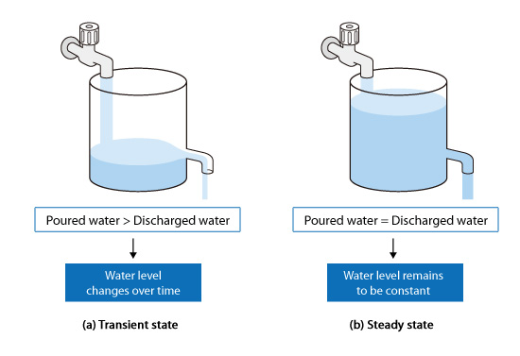
Notation For Steady State Analysis
P_{n} = The probability that there are exactly n customers/jobs in the system (in steady state, i.e., when t→∞)
L = Expected number of customers in the system (in steady state)
Lq = Expected number of customers in the queue (in steady state)
W = Expected time a job spends in the system
Wq= Expected time a job spends in the queue

Slide 33
Little’s Formula Revisited
Assume that λ_{n} = λ and μ_{n} = μ for all n
Assume that λ_{n} is dependent on n

Slide 34
Birth-and-Death Processes
The foundation of many of the most commonly used queuing models
  Birth – equivalent to the arrival of a customer or job
  Death – equivalent to the departure of a served customer or job
Assumptions
Given N(t)=n,
  The time until the next birth (T_{B}) is exponentially distributed with parameter λ_{n} (Customers arrive according to a Po-process)
  The remaining service time (T_{D}) is exponentially distributed with parameter μ_{n}
T_{B} & T_{D} are mutually independent stochastic variables and state transitions occur through exactly one Birth (n → n+1) or one Death (n → n–1)

Slide 35
A Birth-and-Death Process Rate Diagram
Excellent tool for describing the mechanics of a Birth-and-Death process
λ₀
λ₁
λ_{n-1}
λ_{n}
0
1
2
n-1
n
n+1
μ₁
μ₂
μ_{n}
μ_{n+1}
n
= State n, i.e., the case of n customers/jobs in the system

Slide 36
Steady State Analysis of B-D Processes (I)
In steady state the following balance equation must hold for every state n (proved via differential equations)
The Rate In = Rate Out Principle:
Mean entrance rate = Mean departure rate
In addition the probability of being in one of the states must equal 1

Slide 37
Steady State Analysis of B-D Processes (II)
State
Balance Equation
0
1
n
C₀
C₂

Slide 38
Steady State Analysis of B-D Processes (III)
Steady State Probabilities
Expected Number of Jobs in the System and in the Queue
  Assuming c parallel servers

Slide 39
The M/M/1 - model
Assumptions - the Basic Queuing Process
Infinite Calling Populations
  Independence between arrivals
The arrival process is Poisson with an expected arrival rate λ
  Independent of the number of customers currently in the system
The queue configuration is a single queue with possibly infinite length
  No reneging or balking
The queue discipline is FIFO
The service mechanism consists of a single server with exponentially distributed service times
  μ = expected service rate when the server is busy

Slide 40
The M/M/1 Model
λ_{n}= λ and μ_{n} =μ for all values of n=0, 1, 2, …
λ
λ
λ
λ
0
1
2
n-1
n
n+1
μ
μ
μ
μ
Steady State condition: ρ = (λ/μ) < 1
P_{n} = ρ^{n}(1- ρ)
P(n≥k) = ρ^{k}
P₀ = 1-ρ
L=ρ/(1- ρ)
L_{q}= ρ²/(1- ρ) = L-ρ
W=L/λ=1/(μ- λ)
Wq=Lq/λ= λ /( μ(μ- λ))

Slide 41
The M/M/c Model (I)
Generalization of the M/M/1 model
  Allows for c identical servers working independently from each other
λ
λ
λ
λ
λ
0
1
2
c-2
c-1
c
c+1
μ
2μ
(c-2)μ
(c-1)μ
cμ
cμ
Steady State
Condition:
ρ=(λ/cμ)<1

Slide 42
The M/M/c Model (II)
A Condition for existence of a steady state solution is that ρ = λ/(cμ) <1
Little’s Formula ⇒ Wq=Lq/λ
W=Wq+(1/μ)
Little’s Formula ⇒ L=λW= λ(Wq+1/ μ) = Lq+ λ/ μ

Slide 43
Example – ER at County Hospital
Situation
  Patients arrive according to a Poisson process with intensity λ (⇔ the time between arrivals is exp(λ) distributed.
  The service time (the doctor’s examination and treatment time of a patient) follows an exponential distribution with mean 1/μ (=exp(μ) distributed)
  The ER can be modeled as an M/M/c system where c=the number of doctors
Data gathering
  λ = 2 patients per hour
  μ = 3 patients per hour
Questions
  Should the capacity be increased from 1 to 2 doctors?
  How are the characteristics of the system (ρ, Wq, W, Lq and L) affected by an increase in service capacity?

Slide 44
Summary of Results – County Hospital
Interpretation
  To be in the queue = to be in the waiting room
  To be in the system = to be in the ER (waiting or under treatment)
Is it warranted to hire a second doctor ?
Characteristic | One doctor (c=1) | Two Doctors (c=2)
ρ | 2/3 | 1/3
P₀ | 1/3 | 1/2
(1-P₀) | 2/3 | 1/2
P₁ | 2/9 | 1/3
Lq | 4/3 patients | 1/12 patients
L | 2 patients | 3/4 patients
Wq | 2/3 h = 40 minutes | 1/24 h = 2.5 minutes
W | 1 h | 3/8 h = 22.5 minutes

Slide 45
The M/M/c/K – Model (I)
An M/M/c model with a maximum of K customers/jobs allowed in the system
  If the system is full when a job arrives it is denied entrance to the system and the queue.
Interpretations
  A waiting room with limited capacity (for example, the ER at County Hospital), a telephone queue or switchboard of restricted size
  Customers that arrive when there is more than K clients/jobs in the system choose another alternative because the queue is too long (Balking)

Slide 46
The M/M/c/K – Model (II)
Still a Birth-and-Death process but with a state dependent arrival intensity
Observation
The M/M/c/K model always has a steady state solution since the queue can never “explode”

Slide 47
The M/M/c/K – Model (III)
The state diagram has exactly K states provided that c<K
The general expressions for the steady state probabilities, waiting times, queue lengths etc. are obtained through the balance equations as before (Rate In = Rate Out; for every state)
λ
λ
λ
λ
λ
λ
λ
λ
0
1
2
c-1
c
K-1
K
μ
2μ
3μ
(c-1)μ
cμ
cμ
cμ

Slide 48
Results for the M/M/1/K – Model
For ρ = (λ/μ) ≠ 1
Where

Slide 49
The M/M/c/∞/N – Model (I)
An M/M/c model with limited calling population, i.e., N clients
A common application: Machine maintenance
  c service technicians is responsible for keeping N service stations (machines) running, that is, to repair them as soon as they break
  Customer/job arrivals = machine breakdowns
  Note, the maximum number of clients in the system = N
Assume that (N-n) machines are operating and the time until breakdown for each machine i, T_{i}, is exponentially distributed (T_{i}∈exp(λ)). If U = the time until the next breakdown
  U = Min{T₁, T₂, …, T_{N-n}} ⇒ U∈exp((N-n)λ)).

Slide 50
The M/M/c/∞/N – Model (II)
The State Diagram (c service technicians and N machines)
  λ = Arrival intensity per operating machine
  μ = The service intensity for a service technician
General expressions for this queuing model can be obtained from the balance equations as before
Nλ
(N-1)λ
(N-(c-1))λ
λ
0
1
2
c-1
c
N-1
N
μ
2μ
3μ
(c-1)μ
cμ
cμ

Slide 51
Priority-Discipline Queuing Models
For situations where different customers have different priorities
  For example, ER operations, VIP customers at nightclubs…
Assuming a situation with N priority classes (where class 1 has the highest priority) there are two fundamental priority principles to consider.
  Non-Preemptive priorities
    A customer being served cannot be ejected back into the queue to leave place for a customer with higher priority
  Preemptive priorities
    A customer of lower priority that is being served will be thrown back into the queue to leave room for a higher priority customer
Assuming that all customers experience independent exp(μ) service times and arrive according to Poisson processes ⇒ both models can be analyzed as special case M/M/c models

Slide 52
Queuing Modeling and System Design (I)
Design of queuing systems usually involve some kind of capacity decision
  The number of service stations
  The number of servers per station
  The service time for individual servers
  The corresponding decision variables are λ, c and μ
Examples:
  The number of doctors in a hospital,
  The number of exits and cashiers in a supermarket,
  The choice of machine type at a new investment decision,
  The localization of toilets in a new building, etc…

Slide 53
Queuing Modeling and System Design (II)
Two fundamental questions when designing (queuing) systems
  Which service level should we aim for?
  How much capacity should we acquire?
The cost of increased capacity must be balanced against the cost reduction due to shorter waiting time
  Specify a waiting cost or a shortage cost accruing when customers have to wait for service or…
  … Specify an acceptable service level and minimize the capacity under this condition
The shortage or waiting cost rate is situation dependent and often difficult to quantify
  Should reflect the monetary impact a delay has on the organization where the queuing system resides

Slide 54
Different Shortage Cost Situations
External customers arrive to the system
  Profit organizations
    The shortage cost is primarily related to lost revenues – “Bad Will”
  • Non-profit organizations
    The shortage cost is related to a societal cost
Internal customers arrive to the system
  The shortage cost is related to productivity loss and associated profit loss
Usually it is easier to estimate the shortage costs in situation 2. than in situation 1.

Slide 55
Analyzing Design-Cost Tradeoffs
Given a specified shortage or waiting cost function the analysis is straightforward
Define
  WC = Expected Waiting Cost (shortage cost) per time unit
  SC = Expected Service Cost (capacity cost) per time unit
  TC = Expected Total system cost per time unit
The objective is to minimize the total expected system cost
TC
Cost
Min TC = WC + SC
SC
WC
Process capacity

Slide 56
Analyzing Linear Waiting Costs
Expected Waiting Costs as a function of the number of customers in the system
  C_{w} = Waiting cost per customer and time unit
  C_{w}N = Waiting cost per time unit when N customers in the system
Expected Waiting Costs as a function of the number of customers in the queue

Slide 57
Analyzing Service Costs
The expected service costs per time unit, SC, depend on the number of servers and their speed
Definitions
  c = Number of servers
  μ = Average server intensity (average time to serve one customer)
  C_{S}(μ) = Expected cost per server and time unit as a function of μ
SC = c*C_{S}(μ)

Slide 58
A Decision Model for System Design
Determining μ and c
Both the number of servers and their speed can be varied
  Usually only a few alternatives are available
Definitions
  A = The set of available μ - options
  Optimization
    Enumerate all interesting combinations of μ and c, compute TC and choose the cheapest alternative
From a structural point of view, a few fast servers are usually better than several slow ones with the same maximum capacity

Slide 59
Example – “Computer Procurement”
A university is about to lease a super computer
There are two alternatives available
  The M computer which is more expensive to lease but also faster
  The C computer which is cheaper but slower
Processing times and times between job arrivals
are exponential ⇒ M/M/1 model
  λ = 20 jobs per day
  μM = 30 jobs per day
  μC = 25 jobs per day
The leasing and waiting costs:
  Leasing price: CM = $500 per day, CC = $350 per day
  The waiting cost per job and time unit job is estimated to $50 per job and day
Question:
  Which computer should the university choose in order to minimize the expected costs?

Slide 60
Simulation – What is it?
Experiment with a model mimicking the real world system
  Ex. Flight simulation, wind tunnels, …
In BPD situations computer based simulation is used for analyzing and evaluating complex stochastic systems
  Uncertain service and inter-arrival times

Slide 61
Simulation – Why use it?
Cheaper and less risky than experimenting with the actual system.
Stimulates creativity since it is easy to test the effect of new ideas
A powerful complement to the traditional symbolical and analytical tools
Fun tool to work with!

Slide 62
Simulation v.s. Symbolic & Analytical Tools
Strengths
  Provides a quantitative measure
  Flexible – can handle any kind of complex system or statistical interdependencies
  Capable of finding inefficiencies otherwise not detected until the system is in operation
Weaknesses
  Can take a long time to build
    Usually requires a substantial amount of data gathering
  Easy to misrepresent reality and draw faulty conclusions
  Generally not suitable for optimizing system parameters
A simulation model is primarily descriptive while an optimization model is by nature prescriptive

Slide 63
Modern Simulation Software Packages are Breaking Compromises
Graphical interfaces
  Achieves the descriptive benefits of symbolic tools like flow charts
Optimization Engines
  Enables efficient automated search for best parameter values

Slide 64
Building a Simulation Model
General Principles
  The system is broken down into suitable components or entities
  The entities are modeled separately and are then connected to a model describing the overall system
  A bottom-up approach!
The basic principles apply to all types of simulation models
  Static or Dynamic
  Deterministic or Stochastic
  Discrete or continuous
In BPD and OM situations computer based Stochastic Discrete Event Simulation (e.g. in Extend) is the natural choice
  Focuses on events affecting the state of the system and skips all intervals in between

Slide 65
Steps in a BPD Simulation Project
1. Problem formulation
Phase 1
Problem Definition
2. Set objectives and overall project plan
Phase 2
Model Building
3. Model conceptualization
4. Data Collection
5. Model Translation
No
Phase 3
Experimentation
6. Verified
Yes
No
No
7. Validated
Yes
Phase 4
Implementation
8. Experimental Design
9. Model runs and analysis
Yes
No
11. Documentation, reporting and
implementation
10. More runs

Slide 66
Model Verification and Validation
Verification (efficiency)
  Is the model correctly built/programmed?
  Is it doing what it is intended to do?
Validation (effectiveness)
  Is the right model built?
  Does the model adequately describe the reality you want to model?
  Does the involved decision makers trust the model?
Two of the most important and most challenging issues in performing a simulation study

Slide 67
Model Verification Methods
Find alternative ways of describing/evaluating the system and compare the results
  Simplification enables testing of special cases with predictable outcomes
    Removing variability to make the model deterministic
    Removing multiple job types, running the model with one job type at a time
    Reducing labor pool sizes to one worker
Build the model in stages/modules and incrementally test each module
  Uncouple interacting sub-processes and run them separately
  Test the model after each new feature that is added
  Simple animation is often a good first step to see if things are working as intended

Slide 68
Validation - an Iterative Calibration Process
The Real System
Conceptual
validation
Conceptual Model
Assumptions on system components
Structural assumptions which define the
interactions between system components
3. Input parameters and data assumptions
Calibration and
Validation
Model
verification
Operational Model
(Computerized representation)

Slide 69
Example – Simulation of a M/M/1 Queue
Assume a small branch office of a local bank with only one teller.
Empirical data gathering indicates that inter-arrival and service times are exponentially distributed.
  The average arrival rate = λ = 5 customers per hour
  The average service rate = μ = 6 customers per hour
Using our knowledge of queuing theory we obtain
  ρ = the server utilization = 5/6 ≈ 0.83
  Lq = the average number of people waiting in line
  Wq = the average time spent waiting in line
  Lq = 0.83²/(1-0.83) ≈ 4.2 Wq = Lq/ λ ≈ 4.2/5 ≈ 0.83
How do we go about simulating this system?
  How do the simulation results match the analytical ones?

Slide 70

The End
การเข้าแถวคอยและการจําลอง Queuing and Simulationueuing and Simulation
Program in Computer Science, Science and Technology of Faculty, Suan Dusit University

